Slide 1
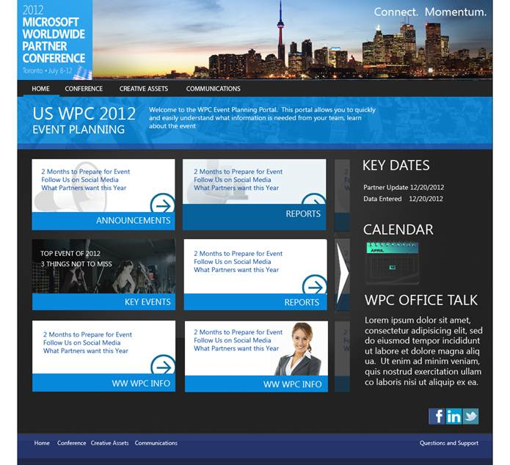
Microsoft WPC 2012 Planning Portal
The Challenge
Microsoft needed an efficient way to prepare for the 2012 Worldwide Partner Conference. Affirma was engaged to develop the WPC 2012 Sub Planning Portal, to be used as a home page for internal team members across the US.
What We Did
Affirma developed the portal from the ground up, including visual design, functionality improvements and rollout. Affirma's team also pre-populated the site with historical data from previous partner conferences.
Results
"Pre-populating the site with historical data from previous conferences was extremely beneficial in allowing us to prepare for the event at significant cost savings. Our team as the information they need at their fingertips and we've seen early partner registration for the conference as a result! The portal has attracted international interest inside of Microsoft as well. Thank you Team Affirma!" - Jemima Herman, Worldwide Partner Conference US Business Lead, US Partner Strategy and Programs Team

